Slide 1
Expenditure Management System
HTML
CSS
JAVASCRIPT
By –
Pranjali Kothari
2018554
4-B

Slide 2
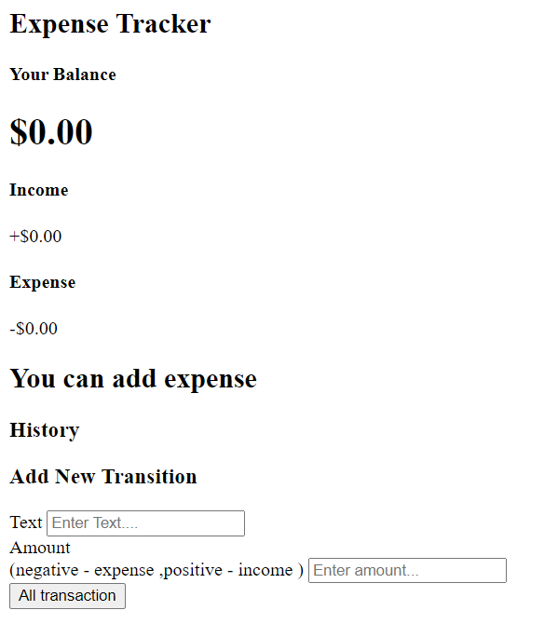
HTML
To design the front-end of webpage
Label
Variables
Text Box
Button

Slide 3
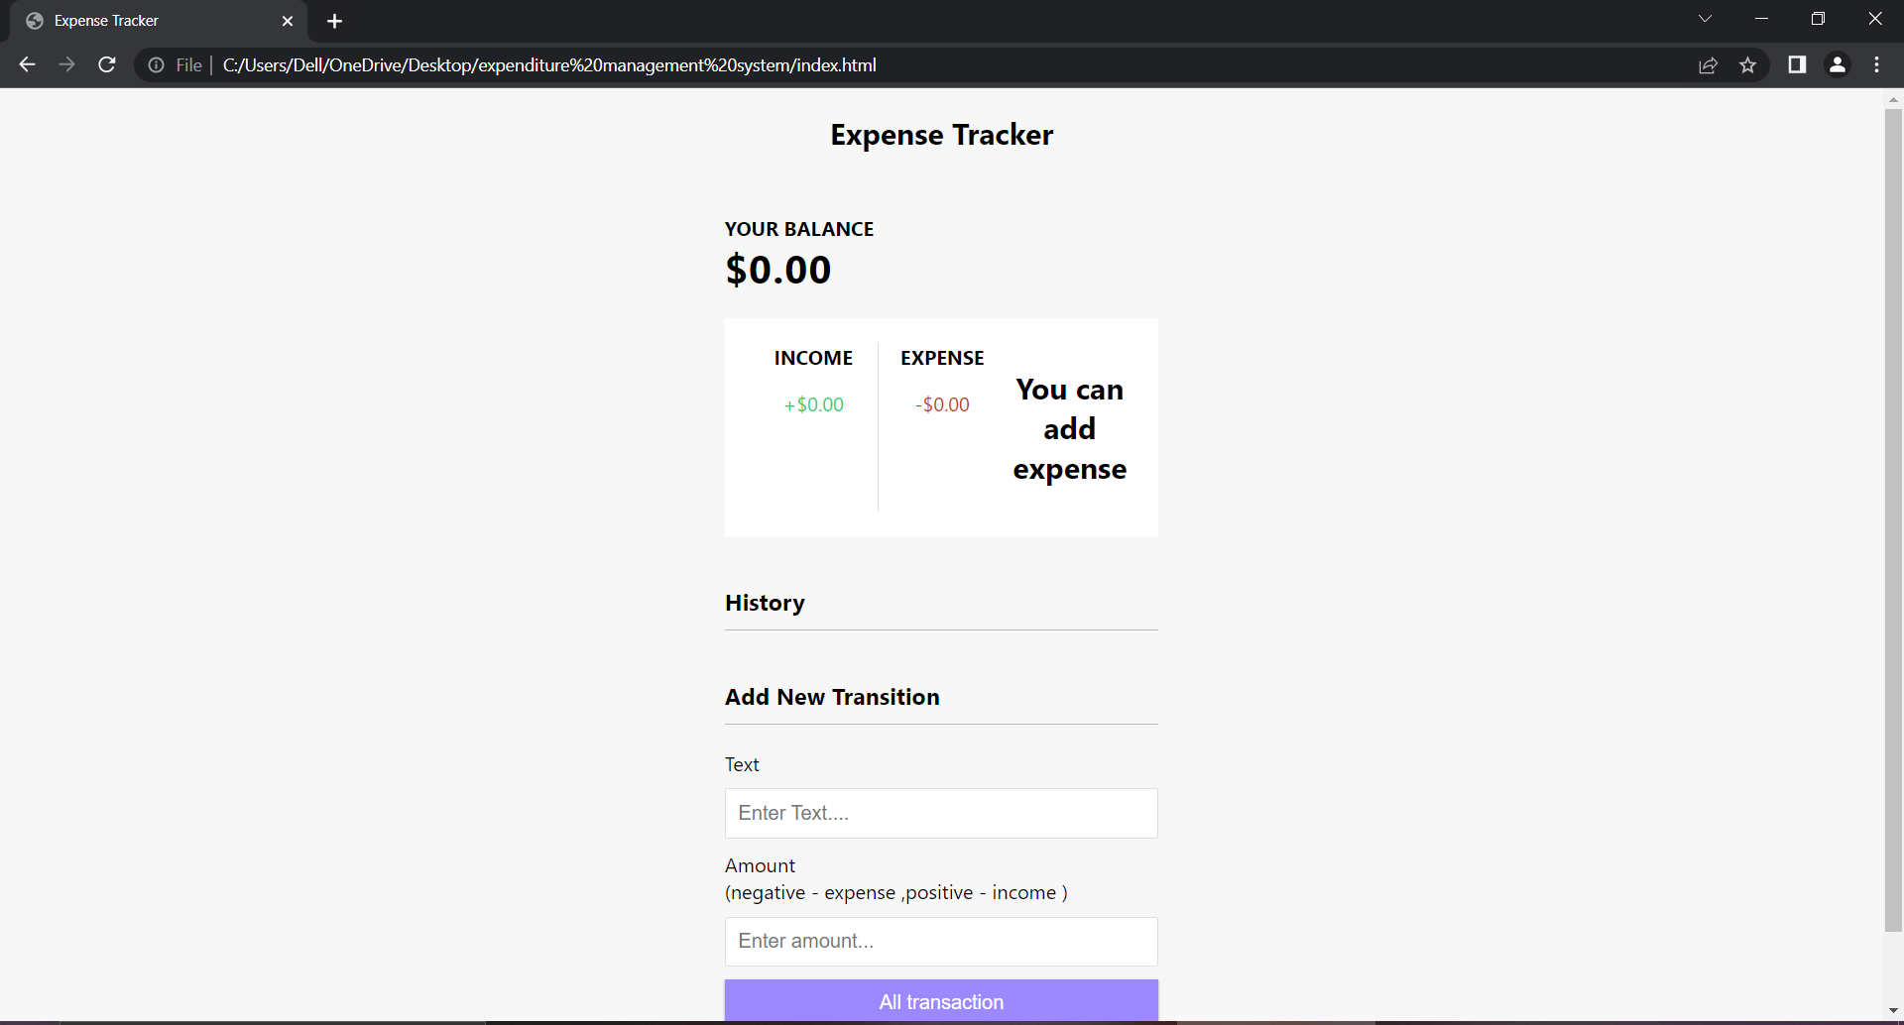
HTML + CSS
To apply style to webpage
Container
Form

Slide 4
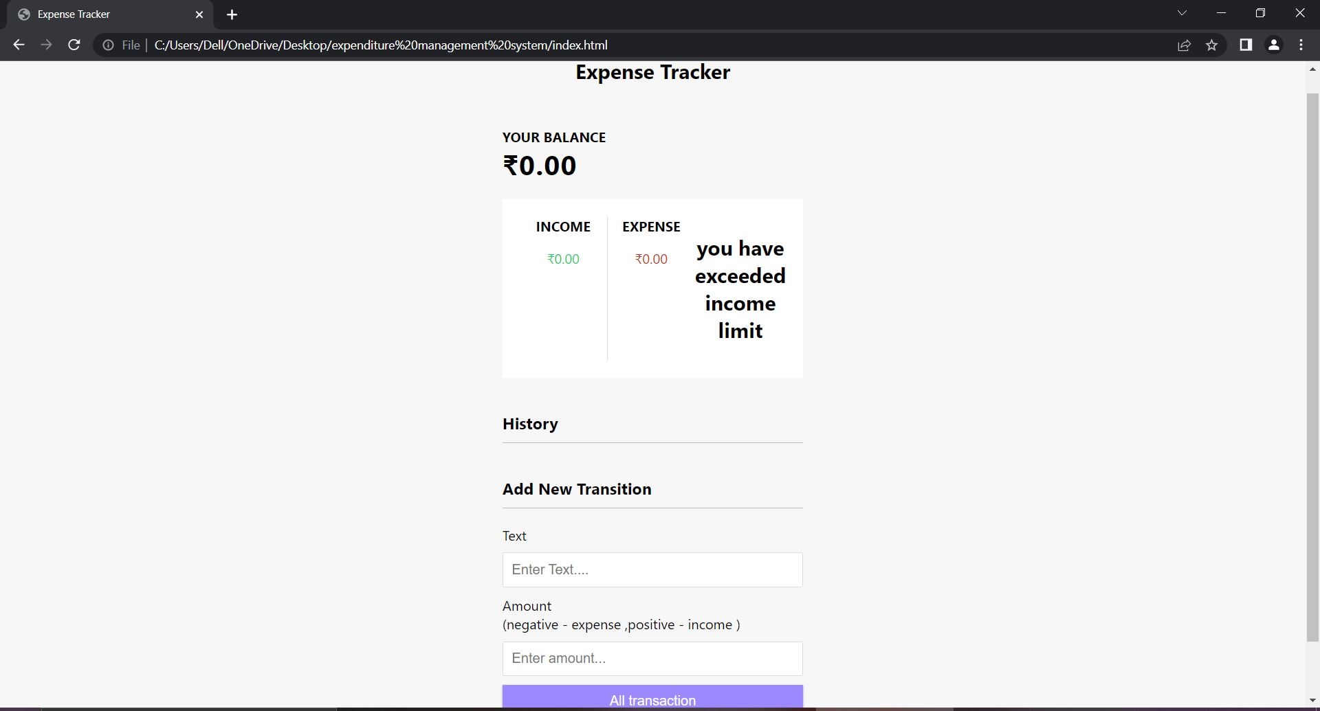
HTML + CSS + JS
To interact with the webpage

Slide 5
Conclusion
The project is designed using HTML, CSS, JavaScript and is working efficiently for the user.
Currently this project is suitable for an individual to keep a track of his expenses. This can be further scaled for use by small business by adding details like category of expenses, credit card, debit card details and tracking the expenses of business and profits earned.

Slide 6

Thankyou

